Slide 1
Open Day 2023

Slide 2
API

Slide 3
OS And Kernel
Types

Slide 4
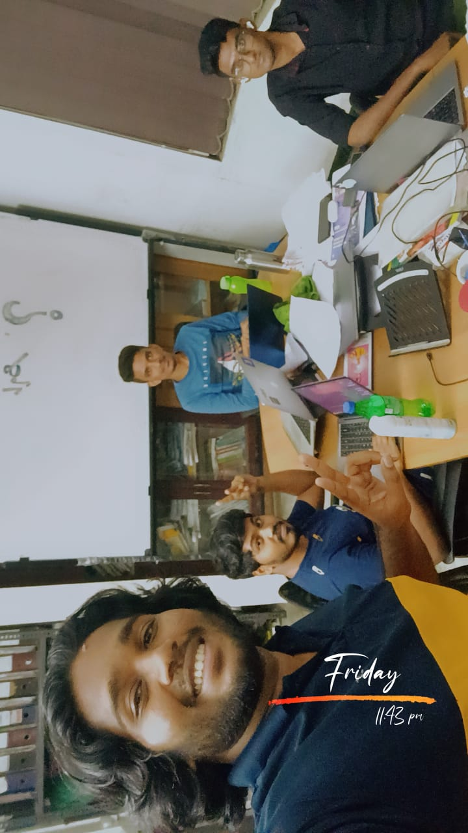
Birth-day Celebration

Slide 5
Down-Graded Erp V13 To V12

Slide 6
Moved all Staging From Digital Ocean to Hetzner

Slide 7
SSH,SCP, RSYNC , SFTP AND ANSIBLE

Slide 8
GAINED KNOWLEDGE ABOUT CLOUD PROVIDERS:
HETZNER
DIGITAL OCEAN
AWS

Slide 9
FRAPPE FrameWork

Slide 10
On Going Project
Reverse Engineering a malware that passed along from a ICICI-Bank Scammer

Slide 11
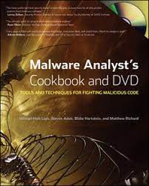
Book I Am Reading

Slide 12
THANK YOU

